Slide 1
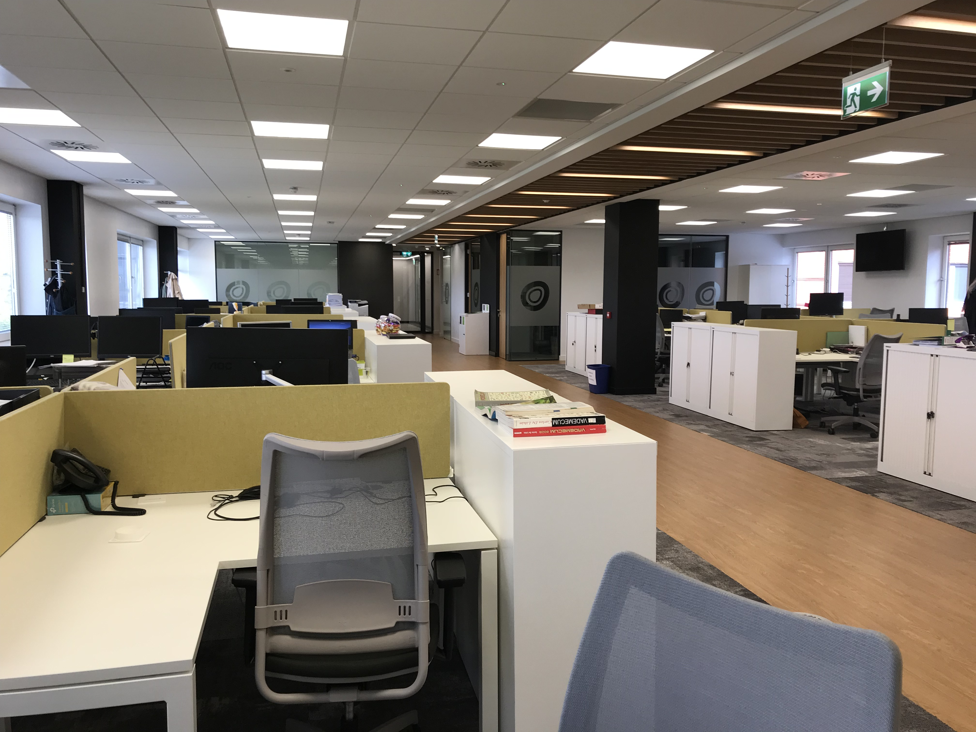
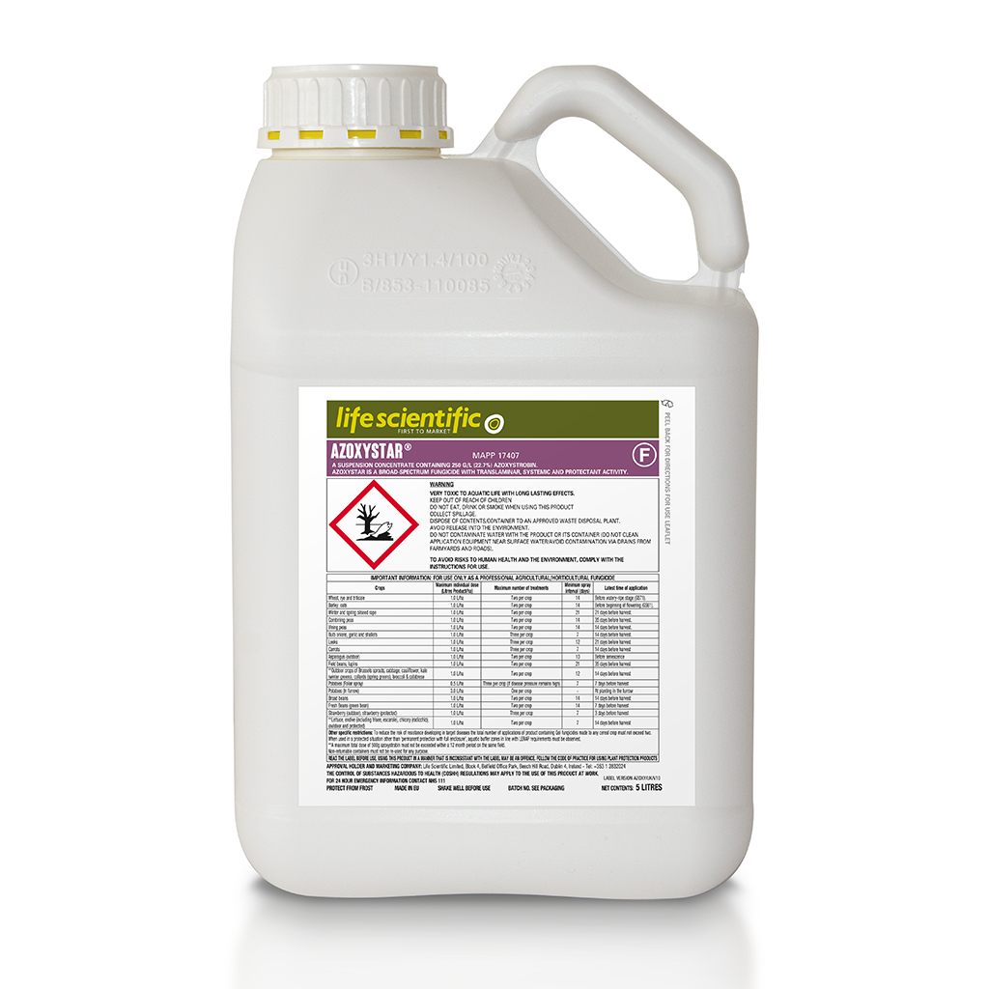
April 2020
Life in Life Scientific…
The unprecedented and unsettling conditions caused by the Covid-19 situation remain in place. Like many businesses, office staff at Life Scientific are working from home, apart from a small number of laboratory staff who are given key worker status by the Irish Government under scientific and research development facilities guidelines.
The Life Scientific team has adapted incredibly well to working from home, and we are confident that we can continue to deliver for our customers, despite the current challenges.
Due to the upturn in weather and growers taking advantage of better application conditions, not only have we launched our new fungicide Aurelia but Life Scientific has seen a great demand for all our product range.
We would like to take the opportunity to say thank you for your business and your patience in these challenging times.
Stay safe everyone.
Product News
As thoughts turn to early cereal fungicide applications growers are keeping an eye on the development of yellow rust in wheat crops.
Azoxystar containing 250g/l azoxystrobin is a broad-spectrum fungicide with translaminar, systemic and protectant activity. It is a particularly effective control of yellow rust Puccinia striiformis.
It can be used with a range of products including CTL.
For more information including product label, safety data sheet and compatible tank mixes see the Life Scientific website https://lifescientific.com/products/ or download the App to get product information direct to your phone.

Slide 2
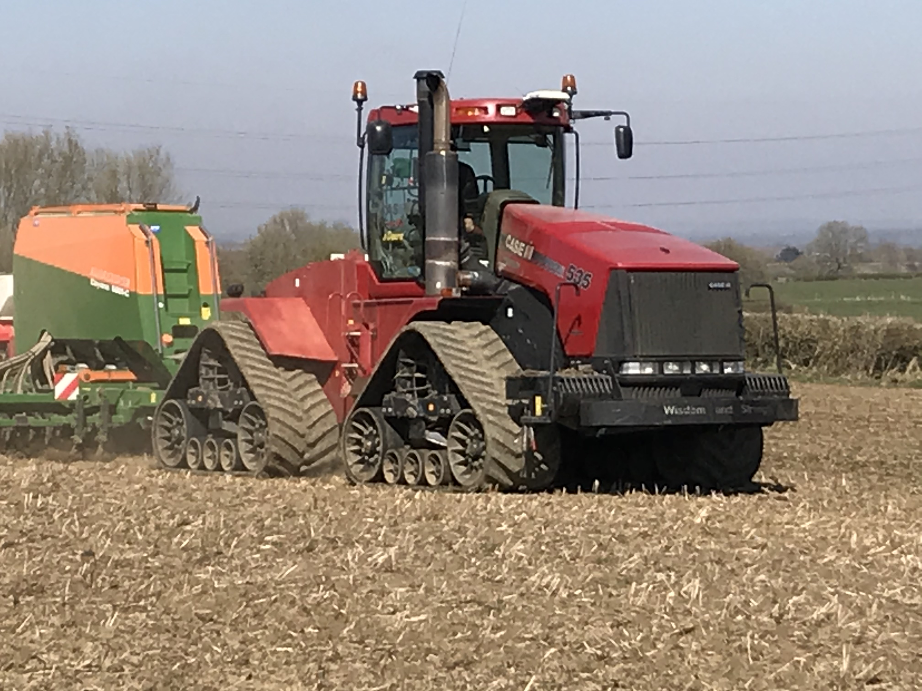
Spring Drilling
Cereal Growth Guide
UK weather has gone from wet to dry and it’s been a busy time drilling spring crops, applying fertiliser, fungicide and herbicide products to existing and newly planted crops.
It’s great to see so much field work taking place after such a long time where it’s been impossible for many growers to turn a wheel, particularly on heavy land. However, avoid the temptation to apply everything in one go, or in less than ideal conditions as this can cause crop damage.
As a general rule, pesticide products should be applied to well established, actively growing crops. SU herbicides such as Cintac and Niantic can cause crop damage if they are applied to crops experiencing large temperature changes, cold nights and warm days for example, particularly when used in large tank mixes. Keep products in the sprayer tank to a minimum.
Check minimum intervals required for some plant growth regulation products.
Life Scientific are pleased to announce another product launch for this season.
Fungicides Esker and Oraso Pro, both containing prothioconazole and tebuconazole are reverse engineed Kestrel and Prosaro.
They will be available from our distribution partners Procam and Hutchinsons later this month.
We’ll tell you more in next months newsletter.
With drilling dates and cereal growth rates at varying points it’s important to identify plant growth stages correctly for effective product application.
Varieties vary in their response to vernalisation and day length. Check AHDB Recommended Lists for more information.
Wheat: T0, early tillering and targeting leaf 4 emerged. Useful for mildew and rust control, fungicides will also have an effect on eyespot and give protection if T1 is delayed. For rusts a strobilurin, such as Azoxystar, will provide disease control and plant greening effects.
T1, optimum timing is just as leaf 3 is fully emerged, GS 31-33. Fungicides should be used to target Septoria and other folia diseases. T1 is also a key timing for eyespot.
T2, sprays should be timed as the flag leaf is fully emerged, GS39. This is the most important timing as fungicides are protecting the top leaves which contribute the most to plant yield. Again Septoria will be the main target but fungicides should also be considered to control rust, particularly on the more susceptible varieties.
T3, is generally early to mid flowering to protect the plant from fusarium and microdochium species which cause ear blight and loss of grain quality. Prothioconazole containing products such as Aurelia, Esker and Oraso Pro can all provide protection from ear diseases when used at this timing.
For more information about Life Scientific and our products. Please see contact methods below.
Ruth.Stanley@lifescientific.com 07857 483 193
Richard.Brereton@lifescientific.com 07384 720 929
Freephone UK telephone number 0800 044 5025
Cintac, Niantic, Azoxystar, Aurelia, Esker and Oraso Pro are registered trademarks of Life Scientific. Cintac and Niantic contain mesosulfuron-methyl and iodosulfuron-methyl-sodium. Azoxystar contains azoxystrobin. Aurelia contains prothioconazole. Esker and Oraso Pro contain prothioconazole and tebuconazole.
All other products are those of other manufacturers where proprietary rights may exist. Use plant protection products safely. Always read the label and product information before use. For further product information including warning phrases and symbols refer to www.lifescientific.com

